Slide 1
An LLVM-based Hybrid Binary Translation System
Bor-Yeh Shen, Jyun-Yan You, Wuu Yang, Wei-Chung Hsu
Institute of Computer Science and Engineering
National Chiao Tung University
Hsinchu City 30010, Taiwan, R.O.C.
{byshen,jyyou,wuuyang,hsu}@cs.nctu.edu.tw

Slide 2
Goal
The goal of the paper is combining the merits of both SBT and DBT.
It first translates binary statically. If a run-time exception happens, the HBT system switches to dynamic translation.
It leverages the LLVM infrastructure to translate source binary code, optimize, and generate target binary code.

Slide 3
Static binary translation (SBT)
merits
SBT can perform whole-program optimizations and do not incur run-time overheads
SBT can perform time-consuming, deep optimizations
disadvantages
SBT is hard to handle code discovery and the code location

Slide 4
Dynamic binary translation (DBT)
merits
DBT is easy to handle code discovery and code location
disadvantage
Translation time of DBT accounts for a part of the execution time
DBT cannot perform aggressive optimizations

Slide 5
LLVM
LLVM is an open source compiler framework which can convert machine-independent instructions to machine-dependent assembly code
LLVM has three part: frontend, optimizer, and backend
In frontend, souce code is translated into LLVM IR
In optimizer, it does optimization on LLVM IR
In backend, LLVM IR is translated into target binary code

Slide 6
SBT in HBT
1) Instructions in the source binary are read and decoded by the object reader and the LLVM MC disassembler respectively.
2) The static translator translates the IR of the LLVM MC disassembler into LLVM instructions (LLVM IR) and saves the result to an LLVM bitcode file.
3) The LLVM optimizer (opt) is used to perform target-independent optimizations on the above bitcode.
4) The optimized bitcode is compiled to the target assembly by the LLVM static compiler (llc). When compiling bitcode to target assembly, llc also performs some target-specific optimizations.
5) The target assembly is assembled to target object code by the target assembler.
6) Finally, the target linker reads a customized linker script generated by the object reader and links the source image together with the target objects. A run-time system which includes a dynamic translator and a system call emulator is dynamically linked with the target binary.

Slide 7
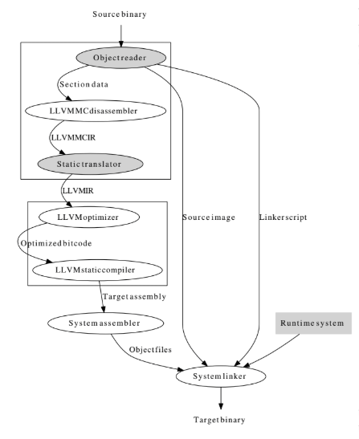

Slide 8
between SBT and DBT in HBT
1) Before the translated binary starts execution, it needs initialization, which includes creating a dynamic translator, allocating stack space for the translated binary, pushing arguments into the source stack, etc.
2) After initialization, execution starts from the program entry point.
3) If the instruction under execution is an indirect branch, the address mapping table is consulted to find the corresponding address in the target binary. Execution continues from that address.
4) If the address mapping table does not contain an entry for the destination of the indirect branch instruction, it will switch to the dynamic translator and looks up the destination of the indirect branch instruction in the code cache. If found, the translated code in the code cache is executed directly. Otherwise, if the destination has not been translated yet, The dynamic translator will find the destination in the source image, translate source instructions, put the translated code in the code cache, and execute the translated code.

Slide 9
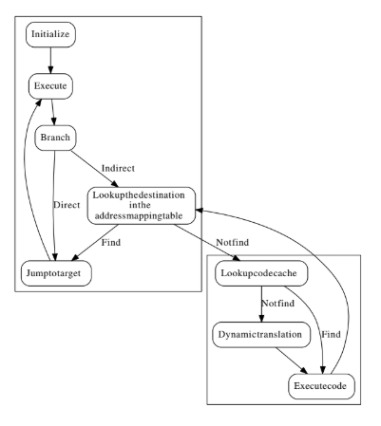

Slide 10
DBT in HBT
1) The dynamic translator translates a contiguous block of instructions (in the source image) into LLVM IR until it meets a branch instruction and performs some basic optimizations on these IR.
2) The LLVM IR is compiled to native code by the LLVM JIT compiler. Some target-specific optimizations are also performed in this stage.
3) The source address of block entry and the entry of its corresponding native code are saved to an address translation table for later code cache lookup.

Slide 11
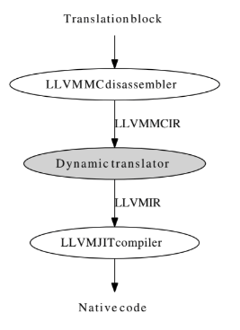

Slide 12
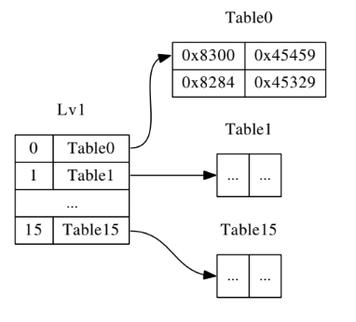
Indirect Branch Handling
Address Mapping Table
entry : an address which indirect branch need in the source image and its corresponding address in the target binary
when branch target address cannot be found in the address mapping table, the dynamic translator is invoked
implement the address mapping table by using the LLVM switch statement

Slide 13
Experimental Results
It compare the difference between LLVM-based HBT and DBT systems
use EEMBC version 1.1 as benchmark
LLVM version 3.0

Slide 14
